Slide 1





National
Oesophago–Gastric Cancer
Audit
2016 Annual Report

Slide 2
This slide set is designed to
  Summarise the findings from the 2016 Annual Report for presentation at local MDT meetings
  Help you to review your local trust practice against other Trusts in your geographical region and against National figures where appropriate.
We have designed the slides so that you can enter your data from the Annexes of the 2016 Annual Report in the appropriate space.

Slide 3
High Grade Dysplasia (HGD) of the Oesophagus
Since April 2012, the NOGCA has been collecting data on patients with HGD of the oesophagus
The audit aims to monitor current practice against national guidelines
The key BSG recommendations are:
  Diagnosis should be confirmed by a second GI pathologist
  Patients should be discussed at a specialist MDT
  Endoscopic treatment is preferred over surgery or surveillance
    EMRs should be performed in high volume centres
Fitzgerald RC et al. British Society of Gastroenterology guidelines on the diagnosis and management of Barrett's oesophagus. Gut. 2014;63(1):7-42.

Slide 4
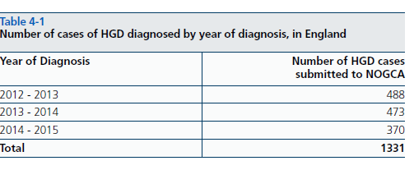
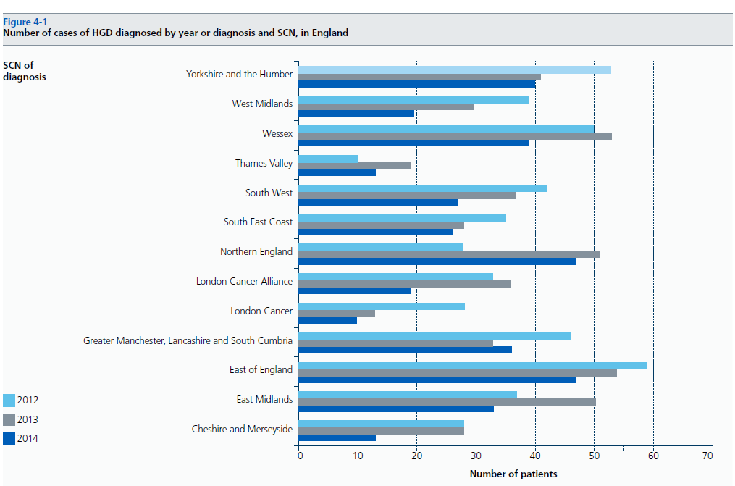
National figures for HGD
1331 cases of HGD submitted to NOGCA over 3 years between 1st April 2012 and 31st March 2015
Fall in cases reported to the NOGCA in 2014-15
Some Strategic Clinical Networks may be under reporting

Slide 5
National figures for HGD
Over the 3-year period:
  Source of referral:
    53.1% Symptomatic
    46.9% Barrett’s surveillance
  78.0% cases had 2nd pathologist confirm diagnosis
  87.4% cases discussed at specialist MDT

Slide 6
National figures for HGD
BSG recommend management of HGD limited to Trusts treating 15 or more cases each year
No. of HGD cases treated was low at many hospitals over 3 years
  Majority treated <15 cases; Only 6 treated ≥45 cases

Slide 7
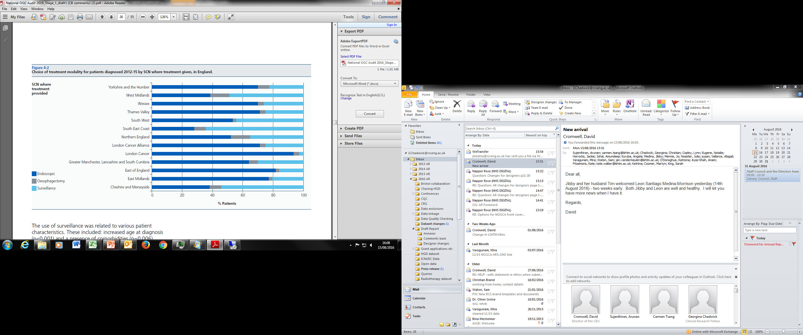
Treatment plan for HGD
BSG recommend endoscopic treatment of HGD in preference over surgery or surveillance
Over 3-years, planned modality was:
  65.7% Endoscopic; 5.4% Surgery; 28.9% Surveillance
  Choice varied significantly by Strategic Clinical Network

Slide 8
Treatment plan for HGD
Proportion managed by surveillance associated with
  Patient factors
    Increased age at diagnosis
    History of comorbidities
    Short segment of Barrett’s
  Hospital factors
    Patients who did not have diagnosis confirmed by second pathologist, (42.3% vs 21.1%, p<0.001)
    Patients who did not have their plan discussed at an MDT, (46.9% vs 24.9%, p<0.001)
    Hospitals treating less than 15 cases each year (p<0.001)

Slide 9
Local HGD Data submissions
Local cases of HGD submitted to NOGCA between 1st April 2012 and 31st March 2015
Insert information from Annex 5 about number of cases of HGD diagnosed at your trust each year
 | Local Trust cases submitted
2012-13 | Xxx
2013-14 | Xxx
2014-15 | xxx
Quality of data submitted to audit
Variable type | Variable Name | Local figures
Mandatory (% with ‘not known’ or ‘NA’ recorded | Source of referral (%) | xxx
 | Diagnosis confirmed by a second pathologist | xxx
Non-Mandatory (% complete) | Length of circumferential Barrett’s | xxx
 | Treatment agreed at MDT | xxx
Insert information from Annex 6 showing quality of data submitted by your NHS trust.
(Annex is limited to Trusts treating ≥10 cases over 3 years.)
Notes:
Complete this slide using data from Annex 5 and 6 of 2016 Annual Report.
NB Trusts who submitted data on less than 10 cases of HGD are not included in Annex 6.

Slide 10
Local Management of HGD
Management of HGD locally between 1st April 2012 and 31st March 2015
 | National | Local Trust
Management
% Discussed at MDT | 87.4% | xx
% Active Management | 71.1% | xx
Insert information from Annex 7 showing data submitted by your NHS trust.
This Annex is limited to Trusts treating ≥10 cases of HGD over 3 years.
Notes:
Complete this slide using data from Annex 7 of 2016 AR

Slide 11
Key findings for HGD
No. of HGD cases submitted to audit has fallen
Good adherence to recommendations about diagnosis confirmed by second pathologist and cases discussed at MDT.
But HIGH proportion of cases managed by surveillance alone
Recommendations
  Local MDTs need clear protocols to ensure all cases of HGD are reported to the NOGCA.
  MDTs should monitor their management
  NHS Trusts and Health Boards should consider referral of patients with HGD to a specialist centre for treatment where local expertise not available.
Notes:
Add slide for any key local findings

Slide 12
Oesophago-gastric (OG) Cancer
2016 Annual Report contains results for patients diagnosed from 1st April 2013 to 31st March 2015
  Results compared with cohort from first audit – patients diagnosed from 1st June 2007 to 31st Oct 2009
Audit prospectively collected data on:
  Patients diagnosed with invasive epithelial OG cancer
  Diagnosed in NHS hospitals in England or Wales
  Aged over 18 at diagnosis

Slide 13
Local OG cancer Data Submissions
Records submitted
 | National | Local Trust
Submission numbers
Cases recorded | 19,866 | xx
% case ascertainment | 79% | xx
Complete this slide using data from Annex 3 of 2016 Annual Report
Completeness of surgical data submitted
  Including the use of ‘unknown’ for mandatory variables
 | Local Trust
% with complications recorded
% with death in hospital recorded
% with date of discharge/death recorded
% with match pathology record
Complete this slide using data from Annex 4 of 2016 AR
NB Trusts who submitted data on less than 10 curative resections are not included in this Annex.

Slide 14
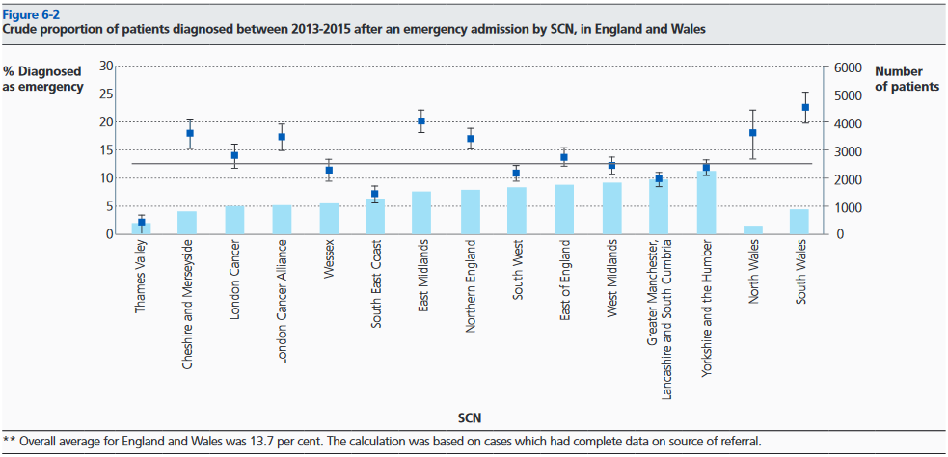
Source of referral
Since 2007-9, there was a fall in proportion of patients diagnosed after an emergency admission.
  13.7% (95%CI 13.2-14.2%) vs 15.3% (95%CI 14.6-16.0)
  BUT rates varied across geographical regions
Locally xx% diagnosed after emergency admission
Complete this slide using data from Annex 8 of 2016 AR
NB Trusts who submitted data on less than 10 cases are not included in this Annex.

Slide 15
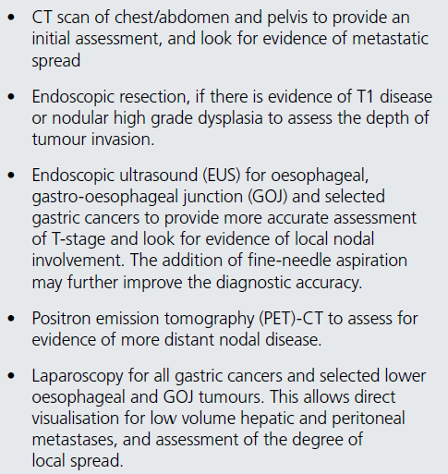
Staging investigations
UK guidelines for staging
Audit Findings
  Nationally 87.2% had staging CT
  Local Trust xx% had staging CT
  Where appropriate
  47.5% had staging EUS
  51.0% had staging laparoscopy
Complete this slide using data from Annex 9 of 2016 AR
NB Trusts who submitted data on less than 10 cases are not included in this Annex.

Slide 16
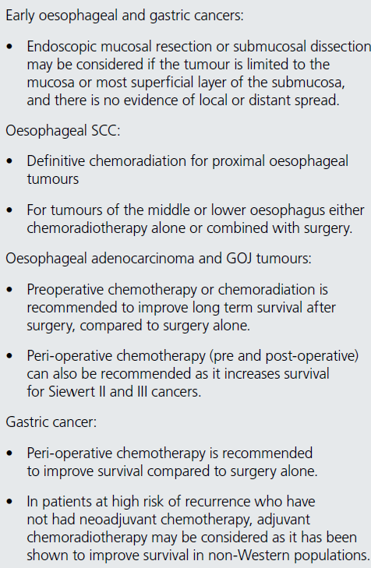
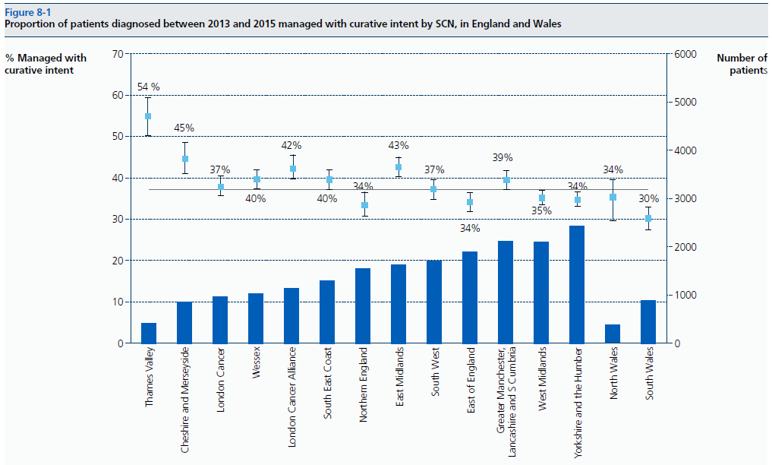
Curative treatment for OG cancer
Overall, 37.6% of patients treated with curative
  Variation seen across regions
  Variation in some SCN may be linked to case-ascertainment

Slide 17
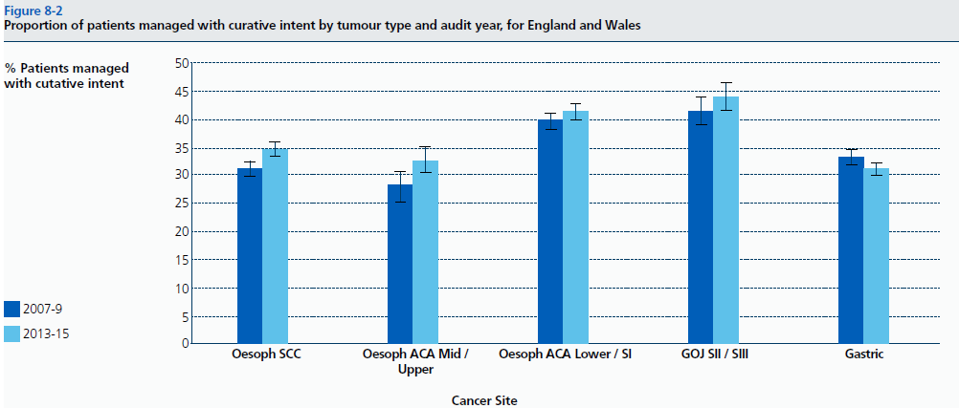
Curative treatment for OG cancer
Proportion managed curatively varied by tumour type
  Growth in proportion of SCCs managed curatively, which may reflect increased use of definitive oncology

Slide 18
Curative surgery
A total of 4,852 curative surgical records were submitted
  3,031 Oesophagectomies
  1,632 Gastrectomies
Rate of open-shut procedures: 3.9% in 2012-15; 5.0% in 2007-09
Minimally invasive (MI) oesophagectomy: 38.9% full-MI or Hybrid in 2012-15; 30.0% in 2007-09

Slide 19
Surgical Outcomes
 | Oesophagectomy (%) |  | Gastrectomy (%)
 | 2007-09 | 2012-15 | 2007-09 | 2012-15
30-Day mortality | 3.8 | 1.6 | 4.5 | 1.9
90-Day mortality | 5.7 | 3.2 | 6.9 | 4.1
Fall in both 30 and 90 day postoperative mortality for curative oesophagectomy and gastrectomy
Overall complication rates remain high

Slide 20
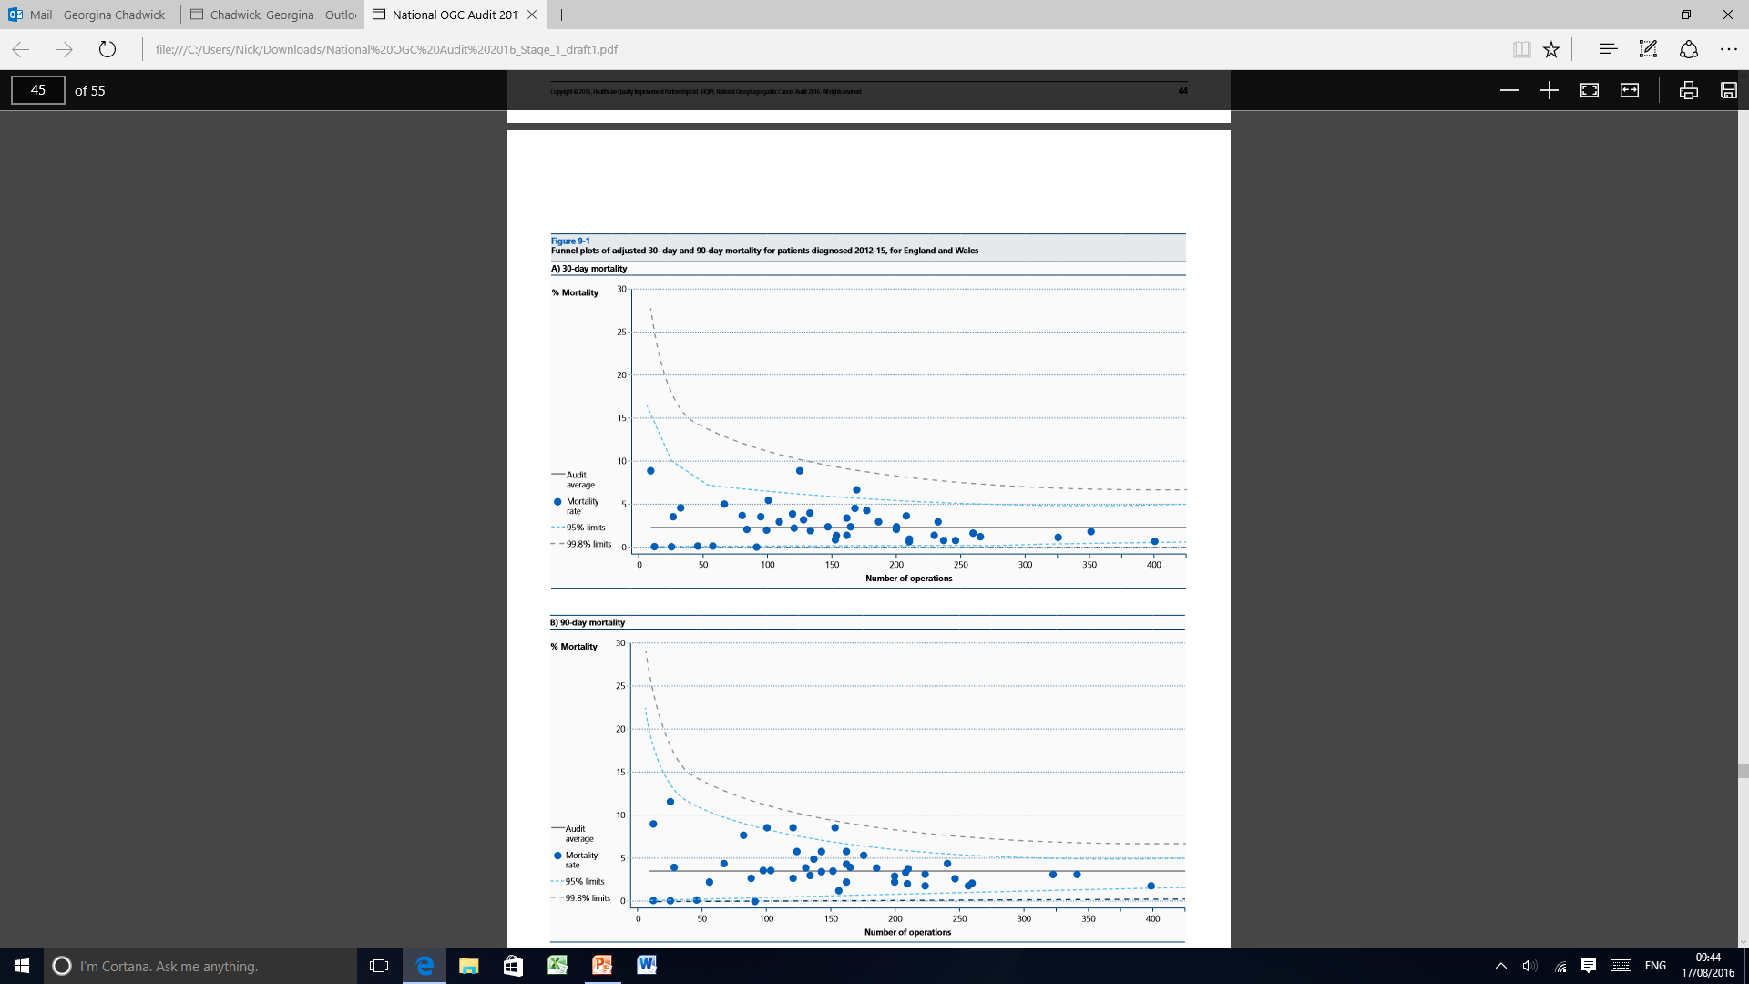
Surgical Outcomes
Complete this slide using data from Annex 10 of 2016 AR
NB Trusts who submitted data on less than 10 curative surgical cases are not included in this Annex.
 | National | Local Trust
Curative surgery volume | 4,852 | xx
Mortality rate
30-day | 2.0% | xx
90-day | 3.9% | xx
Length of stay (median) | 12 days | xx
Notes:
On this slide you can compare your trust’s mortality to national figures and highlight your own trust on the graph

Slide 21
Quality of surgery
Complete this slide using data from Annex 10 of 2016 AR
NB Trusts who submitted data on less than 10 curative surgical cases are not included in this Annex.
 | National | Local Trust
% adequate lymph nodes examined (≥15) | 82.1% | xx
Oesophagectomy
Number performed | 3031 | xx
Positive longitudinal margin | 4.2% | xx
Positive circumferential margin | 27.9% | xx
Gastrectomy
Number performed | 706 | xx
Positive longitudinal margin | 8.6% | xx
Notes:
On this slide you can compare your trust’s quality of surgery to national figures and highlight your own trust on the graph

Slide 22
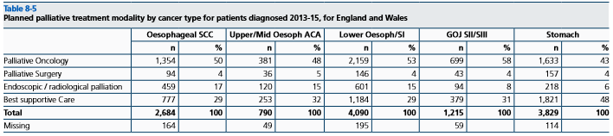
Palliative Treatment for OG cancer
Two thirds of patients managed palliatively
Choice of palliative modality
  Palliative oncology most common, used in 49%
    Lower among older patients with worse performance status
  Choice varied by site of cancer

Slide 23
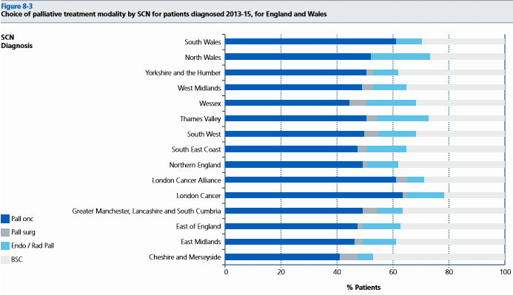
Palliative Treatment for OG cancer
Choice of palliative modality
  Varied by geographical region of diagnosis

Slide 24
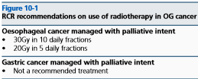
Palliative Oncology
English radiotherapy data (RTDS) linked to NOGCA for patients diagnosed from April 2012 to March 2013
Investigated use of palliative radiotherapy for oesophageal cancer in 1,103 patients with linked data
Treatment use compared to RCR recommendations
  58.1% had recommended regimen
  11.3% had other common palliative regimen e.g. single 8Gy fraction.
  7.3% treated with curative regimen

Slide 25
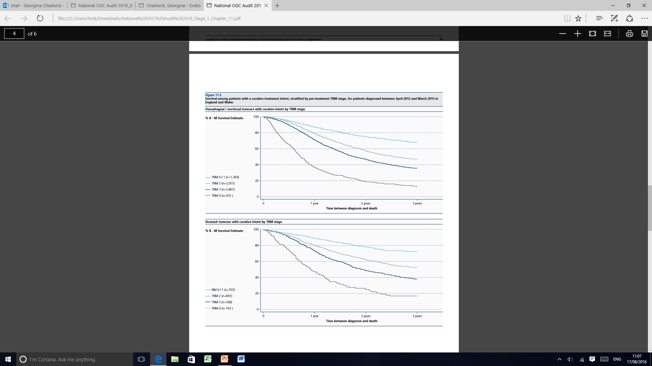
Survival after diagnosis
Analysed survival after diagnosis for patients diagnosed from 1st April 2012 to 31st March 2015
Survival closely linked to TNM stage at diagnosis for patients managed with curative intent
Oesophageal/GOJ
Stomach

Slide 26
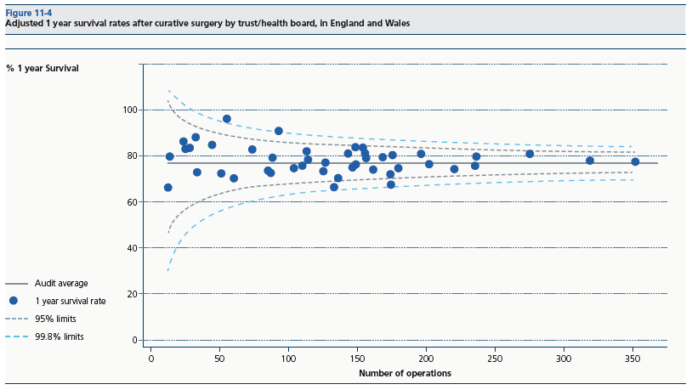
Survival after diagnosis
1-year survival after curative surgery by NHS Trust / Health Board

Slide 27
Key findings for OG Cancer
Proportion of patients diagnosed after emergency admission has fallen, but still 13.7%
Reported use of staging investigations has fallen, with significant variation across trusts
Increase in proportion managed with curative intent, mostly among oesophageal SCCs
Recommendations
  MDTs should monitor routes of referral and investigate if levels of diagnosis after emergency admission are high
  Hospitals need to ensure data on staging investigations is being captured at MDTs

Slide 28
Key findings for OG Cancer
Outcomes after curative surgery steadily improving
  COP next year plan to report on quality of surgery too.
Varied compliance with recommended palliative radiotherapy regimens for oesophageal cancer
Recommendations
  Cancer centres should monitor number of lymph nodes resected and rates of positive resection margins
  NHS trusts / Health Boards evaluate palliative radiotherapy regimens when new guidance comes out from the RCR.

Slide 29
Contact Details
For any queries please contact:
  OG Cancer (NHS Digital)
  E-Mail: ogcancer@nhs.net

