Slide 1







National Oesophago-Gastric Cancer Audit
State of the Nation Report
Slide set, January 2024

Slide 2
This slide set has been created to help NHS organisations:
Present the findings from the NOGCA State of the Nation Report at local meetings
Review how their services and outcomes compare against other NHS trusts / local health boards and against national figures
Figures from your NHS organisation can be found in the online Data Tables for the State of the Nation (SOTN) Report and added to the slides where indicated.
Annual Report and Data Tables: [ADD LINK]

Slide 3
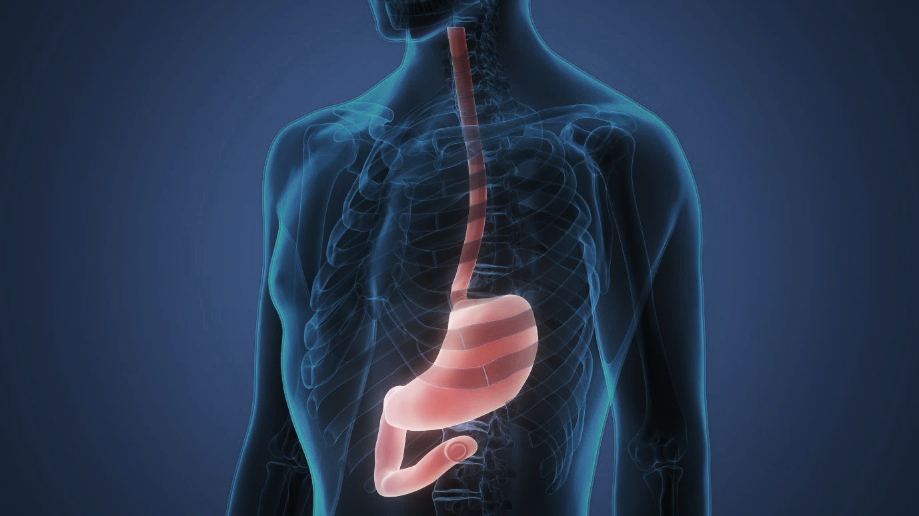
The State of the Nation Report includes:
Patients diagnosed with oesophago-gastric (OG) cancer in England and Wales
Patients diagnosed with oesophageal high grade dysplasia (HGD) in England

Slide 4
Oesophago-gastric cancer

Slide 5
OG cancer data submissions
Review the number of OG cancer records submitted by your NHS trust / local health board and compare these with national figures
Patients diagnosed with OG cancer, 1 April 2020 – 31 March 2022 | England | Wales | Your organisation
Patient records submitted | 18,627 | 1,238 | XX
% case ascertainment | 86.7% | 87.9% | XX
Results for your organisation are in Sheet 4 of the Data Tables

Slide 6
Routes to diagnosis
Among patients diagnosed with OG cancer in 2020-22, 13.1% were diagnosed following an emergency admission
There was substantial variation in rates of emergency diagnosis by Cancer Alliance / Welsh region
Recommendation | Pages of SOTN Report
Cancer Alliances and Wales Cancer Network should review patient pathways in their region to identify opportunities to intervene, and reduce high and variable rates of diagnosis following emergency admission and late stage diagnosis | 5

Slide 7
Routes to diagnosis
Locally, xx% of patients were diagnosed after an emergency admission
(Apr 2020 - Mar 2022)
Results for your organisation are in Sheet 6 of the Data Tables
Adjusted rates of diagnosis after an emergency admission with 95% confidence intervals, by Cancer Alliance / Welsh region.
Blue line shows national average (13.1%).

Slide 8
Staging investigations
It is recommended that all patients with OG cancer have a CT scan to identify metastatic disease
There was substantial variation between NHS organisations in the completeness of information about staging investigations
Locally, xx% of patients had a CT scan (Apr 2020 - Mar 2022)
Results for your organisation are in Sheet 6 of the Data Tables

Slide 9
Use of PET-CT scans among patients with oesophageal and gastro-oesophageal junction cancer (except for T1a tumours) who had curative treatment
PET-CT is recommended for all patients with oesophageal cancer (except for T1a tumours) being considered for curative treatment.
Locally, xx% of patients with a curative treatment plan for oesophageal cancer (except for T1a tumours) had a record of PET-CT (Apr 2020 - Mar 2022)
Results for your organisation are in Sheet 6 of the Data Tables

Slide 10
Data on clinical stage
Clinical stage (pre-treatment) | Oes SCC | Oes ACA | Stomach
Stage 0/1 | 2.7% | 4.4% | 10.8%
Stage 2 | 26.5% | 8.3% | 17.4%
Stage 3 | 38.7% | 40.1% | 26.6%
Stage 4 | 32.1% | 47.2% | 45.2%
Missing | 533 | 1,515 | 892
Total | 3,646 | 11,192 | 5,027
Locally, xx of yy patients had complete clinical stage data
(Apr 2020 - Mar 2022)
Results for your organisation are in Sheet 7 of the Data Tables
Oes – oesophageal; SCC – squamous cell carcinoma; ACA – adenocarcinoma

Slide 11
Treatment plans
Overall, 37.2% of patients with OG cancer diagnosed in 2020-22 had a plan for curative treatment
There was substantial variation by clinical stage
Treatment plan | Oes SCC | Oes ACA Upper/Mid | Oes ACA Lower (w SI,SII) | Stomach (w SIII) | Total
Total patients | 3,646 | 1,622 | 9,570 | 5,027 | 19,865
Curative intent | 38.7% | 34.3% | 40.1% | 31.7% | 37.2%
By clinical stage
0/1 | 81.0% | 91.4% | 95.4% | 69.8% | 81.9%
2 | 58.6% | 58.9% | 66.1% | 52.6% | 59.0%
3 | 46.3% | 48.8% | 59.4% | 51.2% | 54.5%
4 | 14.2% | 14.7% | 16.3% | 4.3% | 12.8%
(missing data) | 533 | 303 | 1,212 | 892 | 2,940
KEY: Oes – oesophageal, SCC – squamous cell carcinoma, ACA – adenocarcinoma, SI, SII, SIII - Siewert classification of the gastro-oesophageal junction (GOJ) [Siewert et al 1996]. See glossary for details.

Slide 12
Treatment plans
Locally, xx% of patients with clinical stage 0-3 disease had a plan for curative treatment (Apr 2020 - Mar 2022)
The national average was 58.4%
Results for your organisation are in Sheet 7 of the Data Tables

Slide 13
Waiting times along the care pathway
Overall, 65.4% of patients diagnosed after an urgent GP referral waited more than 62 days from referral to primary treatment, while 18.7% of patients (all referral routes) waited more than 104 days from referral to primary treatment
Recommendation | Pages of SOTN Report
Review oesophago-gastric cancer care pathways against best practice guidance to identify ways to reduce the proportion of patients with OG cancer waiting more than 62 days from urgent referral to first treatment. | 7

Slide 14
Time from referral to start of curative treatment
Locally, median time from referral to start of curative treatment was xx days (Apr 2020 - Mar 2022)
Results for your organisation are in Sheet 8 of the Data Tables

Slide 15
Time from referral to start of non-curative treatment
Locally, median time from referral to start of non-curative treatment was xx days (Apr 2020 - Mar 2022)
Results for your organisation are in Sheet 8 of the Data Tables

Slide 16
Nutritional support in OG cancer
Locally, information about pre-treatment nutritional support was submitted for xx% of patients
(Apr 2020 - Mar 2022).
Of these, xx% received assessment and advice from a dietitian.
Results for your organisation are in Sheet 11 of the Data Tables

Slide 17
Recommendation | Pages of SOTN Report
Given the often profound impact of OG cancer on patients’ nutritional status, Cancer Alliances and Wales Cancer Network should review specialist dietetic provision across their region, and ensure OG cancer units are resourced according to national specifications to ensure that all patients have access to appropriate dietetic input. | 10

Slide 18
Curative surgery
Among patients diagnosed over three years (April 2019 - March 2022) who had curative surgery, there were:
  3,733 oesophagectomies
  1,720 gastrectomies
 | Oesophagectomy | Gastrectomy | Overall
30-day mortality (95%CI) | 1.4% (1.0 to 1.8) | 1.6% (1.0 to 2.2) | 1.5% (1.2 to 1.8)
90-day mortality (95% CI) | 3.0% (2.5 to 3.6) | 2.5% (1.8 to 3.2) | 2.9% (2.4 to 3.3)

Slide 19
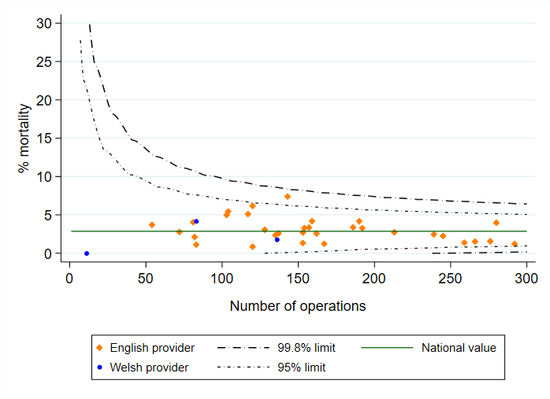
Adjusted 90-day mortality after curative surgery for OG cancer among patients diagnosed April 2019-March 2022 in England and Wales
Local 90-day risk-adjusted mortality rate: xx%
(Local 30-day risk-adjusted mortality rate: xx%)
Results for your organisation are in Sheet 9 of the Data Tables

Slide 20
Pathology outcomes after surgery
Indicator (2019-22) | National average | Your organisation
Proportion of patients with 15 or more lymph nodes examined | 90.1% | XX
Proportion of patients with positive longitudinal margins - oesophagectomy (adjusted) | 4.9% | XX
Proportion of patients with positive circumferential margins - oesophagectomy (adjusted) | 21.5% | XX
Proportion of patients with positive longitudinal margins - gastrectomy (adjusted) | 9.8% | XX
Results for your organisation are in Sheet 9 of the Data Tables

Slide 21
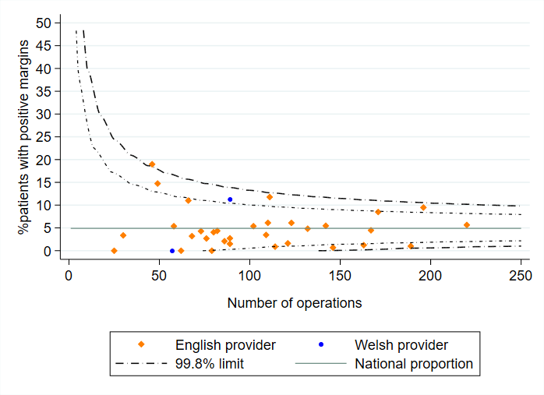
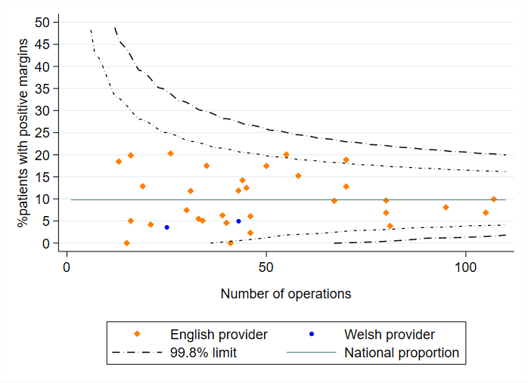
Adjusted rates of positive longitudinal margins
Rates of positive longitudinal margins (risk-adjusted) after surgery for patients diagnosed 2019-22.
Oesophagectomy
Gastrectomy

Slide 22
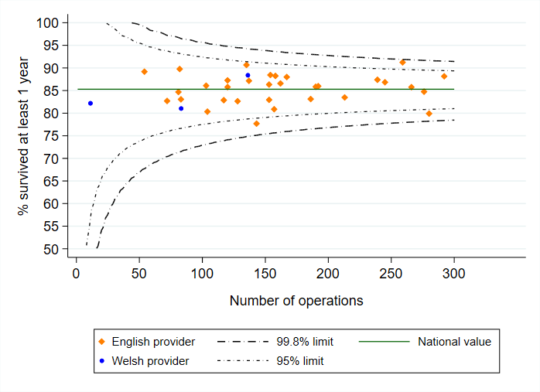
Longer term outcomes after surgery
  Among patients diagnosed between 2017 and 2022 who had curative surgery:
    85.3% were alive at one year, and
    62.7% were alive at three years after surgery.
All surgical centres had an adjusted 1-year survival rate that fell within the expected range

Slide 23
Non-curative oncological treatment by tumour type
 | Oes SCC | Oes ACA Upper/Mid | Oes ACA Lower (w SI,SII) | Stomach (w SIII) | All
Chemotherapy | 412 (47%) | 246 (67%) | 1,569 (70%) | 817 (75%) | 3,044 (67%)
Radiotherapy | 380 (44%) | 101 (27%) | 565 (25%) | 232 (21%) | 1,278 (28%)
Chemo-radiotherapy | 74 ( 8%) | 20 ( 5%) | 90 ( 4%) | 20 ( 2%) | 204 ( 4%)
Immunotherapy (+/- CT/RT) | <10 ( 1%) | <10 ( 1%) | 16 ( 1%) | 16 ( 1%) | 42 ( 1%)
Outcome of chemotherapy
% Completed | 53.8% | 61.7% | 63.0% | 61.1% | 61.1%
Outcome of radiotherapy
% Completed | 96.0% | 97.7% | 97.9% | 99.0% | 97.5%
KEY: Oes – oesophageal, SCC – squamous cell carcinoma, ACA – adenocarcinoma, SI, SII, SIII - Siewert classification of the gastro-oesophageal junction (GOJ)

Slide 24
Non-curative oncological treatment
Recommendation | Pages of SOTN Report
Explore reasons for non-completion of palliative chemotherapy regimens, including review of patients who died within 90 days of starting treatment, and review patient selection for palliative chemotherapy where appropriate. | 9
 | Patients treated | Patients with outcome data | % Patients completing therapy
Chemotherapy | XX | XX | XX
Radiotherapy | XX | XX | XX
Results for your organisation are in Sheet 10 of the Data Tables

Slide 25
High grade dysplasia

Slide 26
Diagnosis of high grade dysplasia
Indicators (based on BSG guideline) | Patients diagnosed 2018-22
 | National | Your Cancer Alliance
% patients whose diagnosis was confirmed by a 2nd pathologist | 90% | XX
% of patients with treatment plan discussed at the multidisciplinary team (MDT) meeting | 93% | XX
Results for your Alliance are in Sheet 3 of the Data Tables

Slide 27
Recommendation | Pages of SOTN Report
In Cancer Alliances with low rates of active treatment for high-grade dysplasia, review reasons for non-treatment and determine if more patients with HGD could be eligible for endoscopic therapy. | 11
Indicators | Patients diagnosed in 2018-22
 | National | Your Cancer Alliance
% of patients who had active treatment | 82% | XX
% of patients who had endoscopic treatment | 78% | XX
Results for your Alliance are in Sheet 3 of the Data Tables

Slide 28
For further details: www.nogca.org.uk

